Slide 1
Message in a Plastic Bottle

Slide 2
Message in a Plastic Bottle
Activity 1 Taste and Odour Test
Does it make sense to buy bottled water?
https://www.youtube.com/watch?v=q3oAv0BjtN4

Slide 3
Message in a Plastic Bottle Activity 1 Taste and Odour Test
Do you think you can tell the difference between tap and bottled water in terms of taste or smell?
Can you predict which one you and the class will prefer?

Slide 4
Message in a Plastic Bottle
Activity 1 Taste and Odour Test
How could you design and conduct a test for odour and taste of bottled and tap water to determine which the class prefers?

Slide 5
Message in a Plastic Bottle
Activity 1 Taste and Odour Test

Slide 6
Message in a Plastic Bottle
Activity 2 Testing the Tap
Who has bought bottled this year?
Why?

Slide 7
Message in a Plastic Bottle
Activity 2 Testing the Tap
What do you think about tap water?
What do you think about bottled water?

Slide 8
Message in a Plastic Bottle
Activity 2 Testing the Tap
What variables could we test in bottled and tap water?

Slide 9
Message in a Plastic Bottle
Activity 2 Testing the Tap
Properties we can test
pH b. hardness
c. Iron d. copper
e. free chlorine f. nitrate and nitrate
g. bacteria (note: the results of this test will be available in 48 hours and might be best done as a demonstration by the teacher).

Slide 10
Message in a Plastic Bottle
Activity 2 Testing the Tap

Slide 11
Message in a Plastic Bottle
Activity 2 Testing the Tap

Slide 12
Message in a Plastic Bottle
Activity 2 Testing the Tap

Slide 13
Message in a Plastic Bottle
Activity 2 Testing the Tap
Neither sample contained any bacteria. The solution turns yellow if bacteria are present.

Slide 14
Message in a Plastic Bottle
Activity 2 Testing the Tap

Slide 15
Message in a Plastic Bottle
Activity 3 Researching the source
Research a brand of bottled water and find out where it comes from.
Is it from a spring? Is it artesian?
Or is it from municipal sources (the tap)?

Slide 16
Message in a Plastic Bottle
Activity 3 Researching the source
Do some brands of bottled water come from the tap? Do you feel duped (tricked) by bottled water companies?

Slide 17
Message in a Plastic Bottle
Activity 3 Researching the source

Slide 18
Message in a Plastic Bottle
Activity 4 Science of Plastics in our Oceans
Watch
www.youtube.com/watch?v=os7OuSxP-JA (Take3)
www.youtube.com/watch?v=M4UK9Yt6A-s. (Charting the GP)
‘How does this make you feel about plastic?’

Slide 19
Message in a Plastic Bottle
Activity 4 Science of Plastics in our Oceans
So what can we do
*Stop using plastic straws.
*Use a reusable produce bag. A single plastic bag
can take 1,000 years to degrade.
*Use a reusable drink bottle or mug for your
beverages, even when ordering from a to-go shop
*Give up gum. Gum is made of a synthetic rubber,
aka plastic.

Slide 20
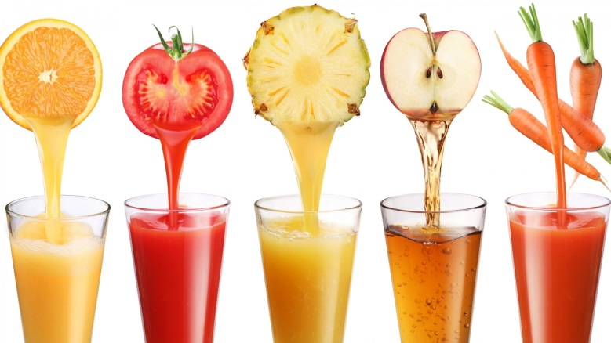
Message in a Plastic Bottle
Activity 4 Science of Plastics in our Oceans
*Buy boxes instead of bottles. Often, products like laundry detergent come in cardboard which is more easily recycled than plastic.
*Don't use plastic ware (plates and cutlery) at home or BBQ’s.
*Make fresh squeezed juice or eat fruit instead of buying juice in plastic bottles. It's healthier and better for the environment.

Slide 21
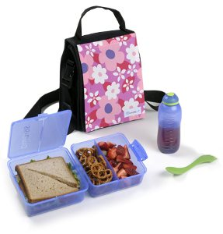
Message in a Plastic Bottle
Activity 4 Science of Plastics in our Oceans
*Make your own cleaning products that will be less toxic and eliminate the need for multiple plastic bottles of cleaner.
*Pack your lunch in reusable containers
and bags. Also, opt for fresh fruits and
veggies and bulk items instead of
products that come in single serving
cups.

Slide 22
Message in a Plastic Bottle
Activity 4 Science of Plastics in our Oceans
Go to adrift website and experiment with how plastics can move through the ocean over time.
www.adrift.org.au.
www.youtube.com/watch?v=vh6MDuxYing.

Slide 23
Message in a Plastic Bottle
Activity 4 Science of Plastics in our Oceans
Research and answer the following questions
Where do plastics come from? Are plastics a renewable
resource?
b. When was plastic first developed? When did it become
widely used? What properties make plastic beneficial for
things like food storage?
c. Science may have provided plastic as a solution to food
storage and packaging but it has impacted upon society.
What happens to plastic once it enters the ocean?
d. How has science helped us to understand the way plastic
moves in the ocean?
e. How are plastics in our ocean harmful to marine life?
f. Draw a food chain to show how plastic accumulates in
larger sea life (and even humans).

